Slide 1
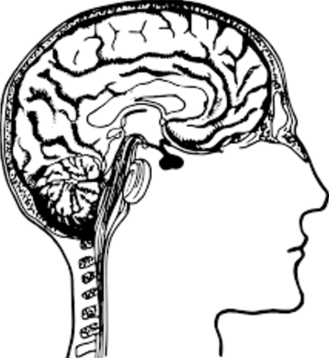
CNS – The Brain
Ch 4 Human Perspectives – The Nervous System is Highly Organised

Slide 2
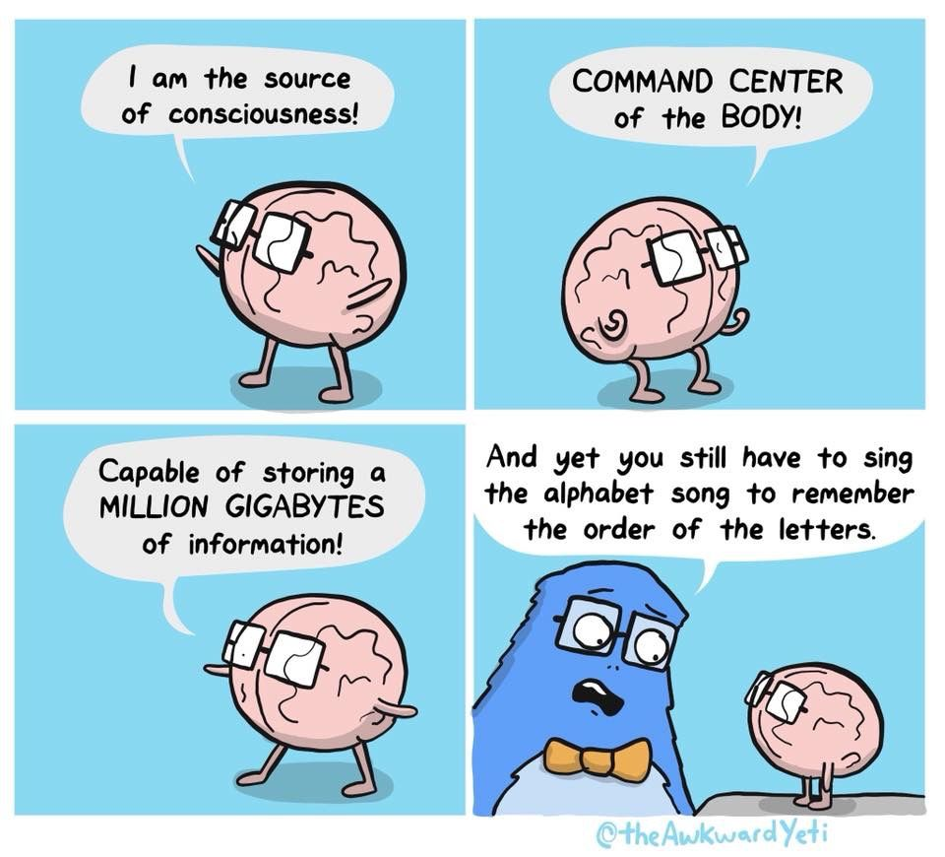
Date: | Human Biology Year 12 ATAR
Do Now Complete the past exam question given, under test conditions (not for actual marks) Lesson Agenda 1: Do Now 2: The Brain – structures and functions 3: Work on Review Worksheet: The brain 4: Lesson summary and wind-up Suggested Study Complete review worksheet, mark and correct using answer key on Connect. Read through today’s notes and textbook section Write out the steps involved in transmission across the synapse. NEXT LESSON Past Exam Question CNS Protection | Learning Aims Describe the location and function of the following areas of the brain: Cerebrum Corpus callosum Cerebellum Hypothalamus Medulla Oblongata Spinal cord Describe parts of the cerebrum and the functions of each Describe how impulses move to, from and within the brain
 | Key Vocabulary Cerebrum Cerebral cortex Cerebellum Corpus Callosum Hypothalamus Medulla Oblongata Spinal Cord

Slide 3
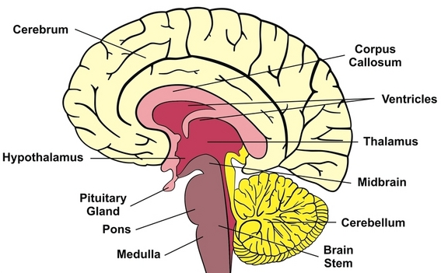
The Brain
Complex organ in structure and function
Still not fully understood
Works as an integrated whole
For Human Bio ATAR, we look at major parts that have major functions
Damage to any part can profoundly affect function.
We will look at:
Cerebrum
Cerebellum
Hypothalamus
Medulla Oblongata
Corpus Callosum

Slide 4
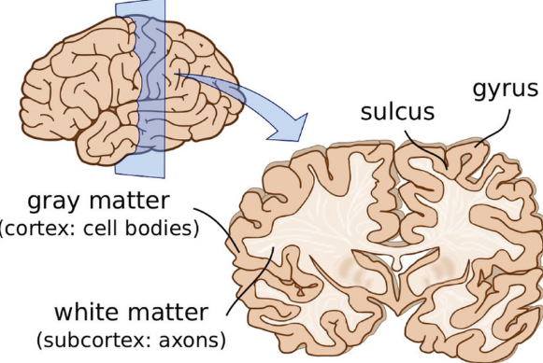
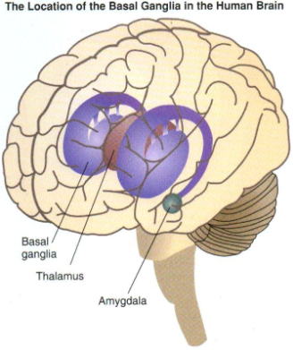
The Cerebrum
Biggest part of the brain
Cerebral cortex:
Outer layer
Grey matter (cell bodies)
White matter
Below cortex
Axons
Basal Ganglia
Deep within cerebrum
Additional grey matter
Learning Aim: Describe the location and main functions of the cerebrum

Slide 5
The Cerebrum
Folded Surface
Increase surface area
Fits 70% of neurons in CNS
Ridges
Called Convolutions or Gyri (s. gyrus)
Downfolds
Shallow ones called sulci (s. sulcus)
Deep ones called Fissures
Longitudinal Fissure
Separates cerebrum into two hemispheres
Corpus callosum joins the hemispheres at the base.
Learning Aim: Describe the main features of the cerebrum

Slide 6
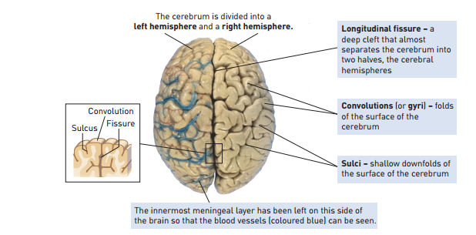
Learning Aim: Describe the main features of the cerebrum

Slide 7
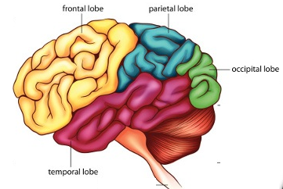
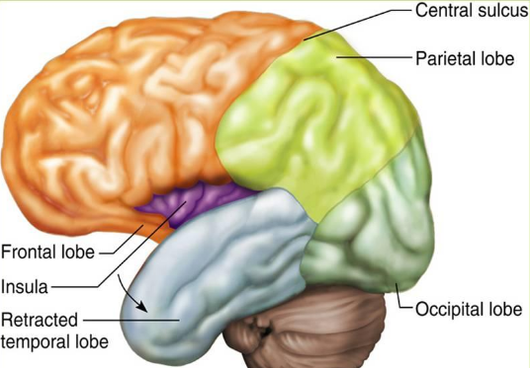
The Cerebrum
Each hemisphere: 4 lobes
Frontal
Temporal
Occipital
Parietal
Insula (like a 5th lobe)
Learning Aim: Describe the main features of the cerebrum

Slide 8
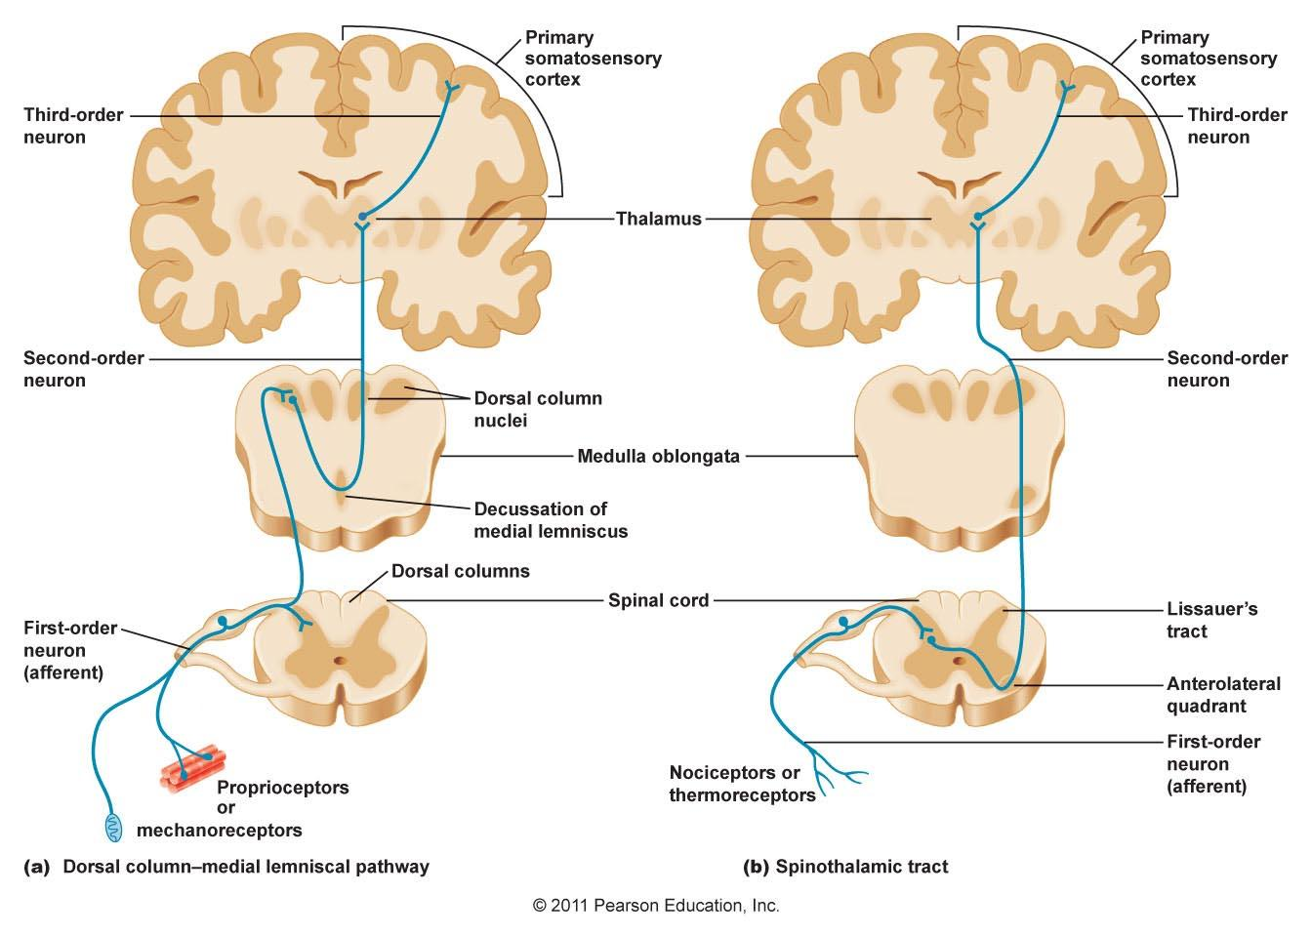
note: this is a couple of examples only. There are MANY more
Pathways to the Cerebral Cortex
Learning Aim: Understand some pathways involved in sensory impulses reaching the cerebrum.

Slide 9
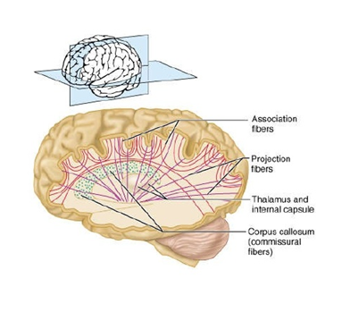
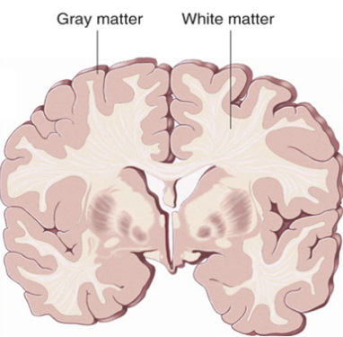
Cerebral White Matter
Myelinated axons
Bundles of nerve fibres in CNS are called tracts
3 types of tracts in white matter:
Tracts connecting parts of cortex within same hemisphere – Association Fibres
Tracts between left and right hemispheres – Commissural Fibres (including Corpus Callosum)
Tracts connecting cortex to other parts of brain or spinal cord – Projection Fibres
Learning Aim: Describe the types of connections (tracts) in the cerebrum

Slide 10
Functions of the Cerebrum
Thinking, reasoning, learning, memory, intelligence
Sensory Perception
Control of voluntary muscle contraction
Memory held via circuits and links rather than special “cells”
The cerebrum can be studied via:
Looking at brainwaves: Electroencephalogram
Changes to blood flow
Effects of damage and disease
Experimentation on other mammals.
These have enabled the cerebrum to be partially mapped for function
Learning Aim: Describe the functions of the cerebrum and how it can be studied.

Slide 11
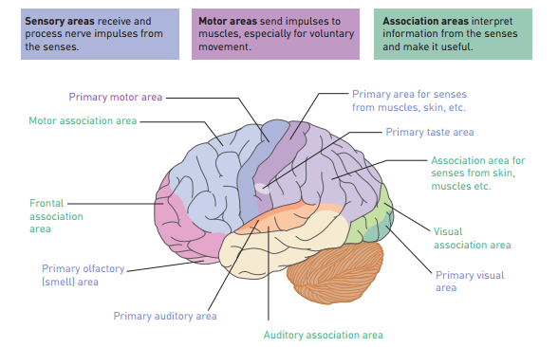
Learning Aim: Describe the main areas of the cerebrum and the functions they are responsible for.

Slide 12
Left vs Right Hemispheres – the facts
Some differences eg
Language ability – left
Music, art – right
Both sides used equally though.
People are not “left brained” or “right brained”.

Slide 13
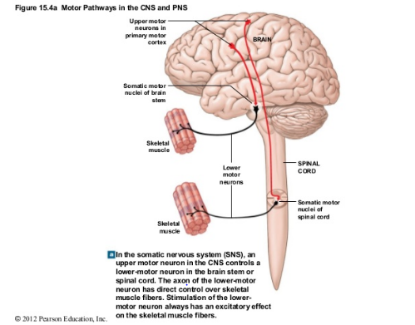
Pathways from the Cerebral Cortex note: this is one example only. There are MANY more
Learning Aim: Understand some pathways involved in motor impulses leaving the cerebral cortex.

Slide 14
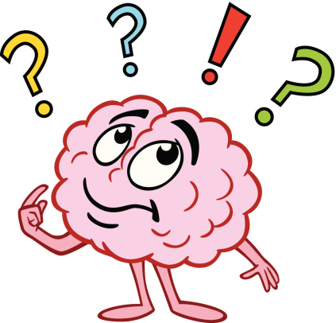
Brain structures other than cerebrum
Chapter 4 HP
Corpus Callosum
Cerebellum
Hypothalamus
Medulla Oblongata
Spinal Cord

Slide 15
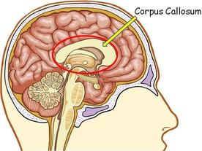
Corpus Callosum
Wide band of nerve fibres
At base of longitudinal fissure
Allow the 2 sides of cerebrum to communicate
Learning Aim: Describe the location and function of the Corpus Callosum.

Slide 16
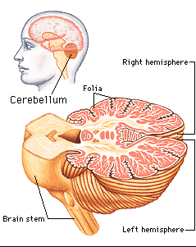
Cerebellum
Under rear of cerebrum
Highly folded surface
Control over:
Balance
Posture
Fine coordination of voluntary muscle movement
Receives input from inner ear, stretch receptors in skeletal muscles.
“smooths” and coordinates movement.
Learning Aim: Describe the location and function of the Cerebellum.

Slide 17
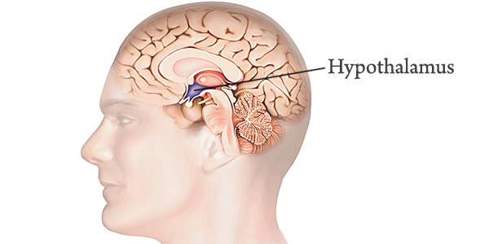
Hypothalamus
Deep in middle of brain
Small but controls many activities
Homeostatic control
Autonomic nervous system coordination
Body temperature
Food and water intake
Emotional responses
Coordination of parts of endocrine system
Metabolism
Growth
Reproduction
Responses to stress
Learning Aim: Describe the location and functions of the Hypothalamus

Slide 18
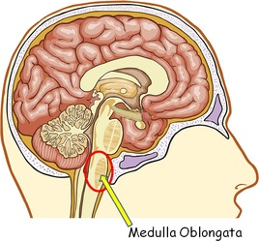
Medulla Oblongata
Continuation of spinal cord at base of brain.
Nerve fibres pass through on the way to other centres
Also has role in coordinating key body functions:
Cardiac centre: rate and force of heartbeat
Respiratory centre: rate and depth of breathing
Vasomotor centre: diameter of blood vessels – blood pressure
Swallowing, coughing, sneezing, vomiting reflexes
Interacts with hypothalamus and other higher brain centres to control homeostasis.
Learning Aim: Describe the location and function of the Medulla Oblongata.

Slide 19
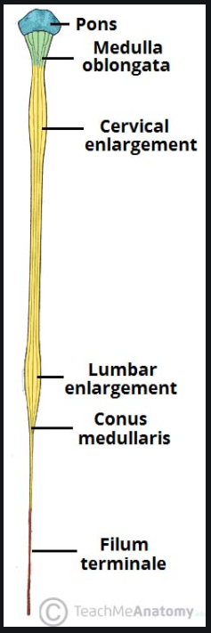
Spinal Cord
Extends from base of skull down spinal column
Heavily protected by bone, meninges, CSF
Grey matter at centre, white matter at outside
White matter in bundles
Ascending tracts – sensory axons
Descending tracts – motor axons
Carries impulses up and down between brain and body
Coordinates some reflexes
Learning Aim: Describe the structure and function of the spinal cord.

Slide 20
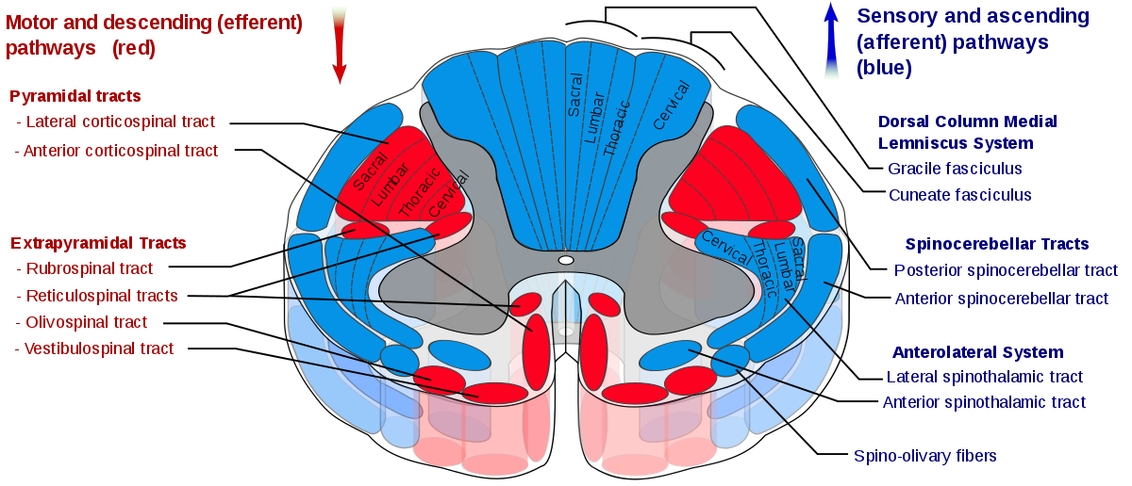
Don’t stress – you don’t need to know this in detail – its just to show you where the sensory neurons run and where the motor ones run

Slide 21
